Slide 1
Gender & Language
~Group 4~

Slide 2
Some claims:
1) Men interrupt women more than vice versa.
2) Women are more communicative than men.
3) Men do not give verbal recognition of the contributions in the
conversation made by women.
4) Men curse more than women.
5) Women gossip more than men.
6) Women talk more with one another than men do.
7) Men speak more comfortably in public than women

Slide 3
What Is Gender? The differences between gender and sex.
-"Gender" can refer to the role of a male or female in society, known as a gender role, or an individual's concept of themselves, or gender Identity.
-“Sex" refers to the biological differences between males and females, such as the genitalia and genetic differences.
-General usage of the term gender began in the late 1960s and 1970s, increasingly appearing in the professional literature of the social sciences. The term helps in distinguishing those aspects of life that were more easily attributed or understood to be of social rather than biological origin (see e.g., Unger & Crawford, 1992).

Slide 4
Why women communicate?
Women focus on feelings, relationships & personal problems
The most satisfaction women get from talking with friends is empathy
Women use communication to explore and organize her thoughts

Slide 5
Why men communicate?
Men discussions involve jokes, playful talks and good nature teasing
Men are more likely to use communication to finish jobs or tasks rather than nourishing friendships
Men tend not to emphasize
Men’s contribution to arguments are simple and direct
Men will often become quiet and withdrawn when they’re upset or down

Slide 6
Gender agreements in some languages
(1) Greek o andras = the masculine man, i gyneka = the feminine woman and to pedhi = the neutral child
(2) German der man the masculine man die Frau = the feminine woman and das Kind = the neutral child
(3) French l(e) homme= the masculine man and la femme = the feminine woman
Indo-european had gender distinction; Swahili has 16 gender distinctions

Slide 7
Does gender influence our perception of categories?
Some may think that it does!
Borodisky, Schmit, and Phillips (2002): German versus Spanish gender oosative versus soupative distinction in Gumpuzi
The question must be understood within the context of whether language influences thought (the Sapir-Whorf hypothesis)

Slide 8
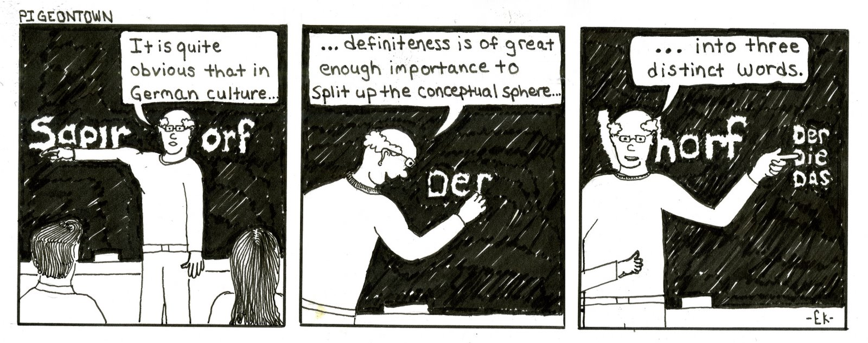
The Whorfian Hypothesis
“We dissect nature along lines laid by our own language. […] the world is presented as a kaleidoscope flux of impressions which has to be organized by our minds—and this means largely by the linguistic systems in our minds.”
A theory in linguistics: one's language determines one's conception of the world

Slide 9


More on The Whorfian Hypothesis

Slide 10
Back to gender…
Greek: o helios = the sun (masculine) and i selene = the moon (feminine)
German: die Sonne = the sun (feminine) and der Mond = the moon (masculine)
Question: Should the contrast be taken to suggest that the Germans and Greek perceive the moon and the sun differently?
Answer: Not really! It seems more reasonable to believe that human conceptual structure remains constant in its core features across languages.

Slide 11
Non-gender variables
Non-gender variables are the factors that affect communication but don’t involve gender
There are more similarities than differences in the way men and women communicate
There is no difference in profanity between genders: No gender is more abusive than the other
Example: Men & women supervisors are shown to behave the same way and are equally effective

Slide 12
In Conclusion
Gender can affect communication in many different ways
In a communication, avoid being sexist
Respect one another when communicating
Don’t make assumptions based on stereotypes

